Slide 1
Module 6: Co-Processor

Slide 2
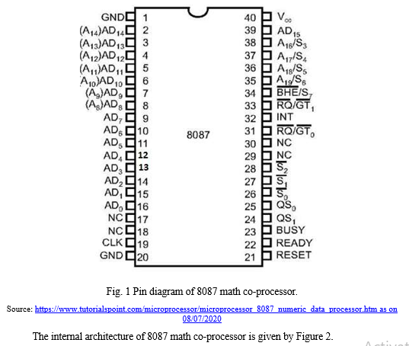
Architecture of 8087

Slide 3
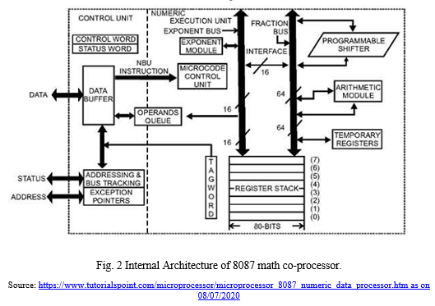

Slide 4
The architecture of 8087 has two main units as follows:
Control Unit
Execution Unit

Slide 5
1. Control Unit
The main aim of the control unit is to synchronize the operations of the microprocessor and co-processor.
The main components of this unit are the
Control Word,
Status Word
Data Buffer.
If the given instruction is a co-processor instruction, then, the co-processor executes it, otherwise, the microprocessor executes it.

Slide 6
Status Register
Each entry of the status register is explained as follows:
C3-C0 - Condition code bits
TOP - Top-of-stack (ST)
ES - Error summary
PE - Precision error
UE - Under flow error
OE - Overflow error
ZE - Zero error
DE - Denormalized error
IE - Invalid error
B - Busy bit

Slide 7
Control Register
IC - Infinity control
RC - Rounding control
PC - Precision control
PM - Precision Mask
UM - Underflow mask
OM - Overflow mask
ZM - Division by zero mask
DM - Denormalized operand mask
IM - Invalid operand mask

Slide 8
2. Execution Unit
This performs the operations that access the numeric data available in the registers of the co-processor.
The Numeric Registers are 80 bits wide.
They are present in the NUE which is capable of performing arithmetic, logic and transcendental operations.
It can also supply small mathematical constants from its ROM.

Slide 9
Weblinks
http://www.idc-online.com/technical_references/pdfs/electronic_engineering/8087_Co_Processors_and_Architechture.pdf
https://www.tutorialspoint.com/microprocessor/microprocessor_8087_numeric_data_processor.htm

